Slide 1








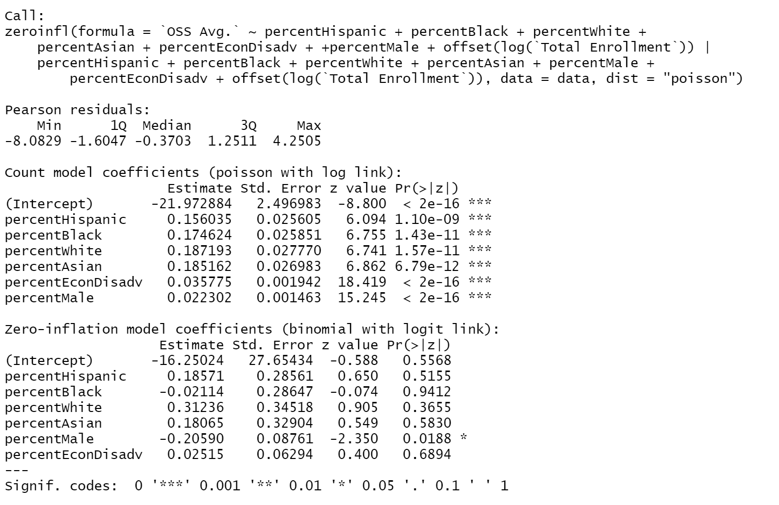
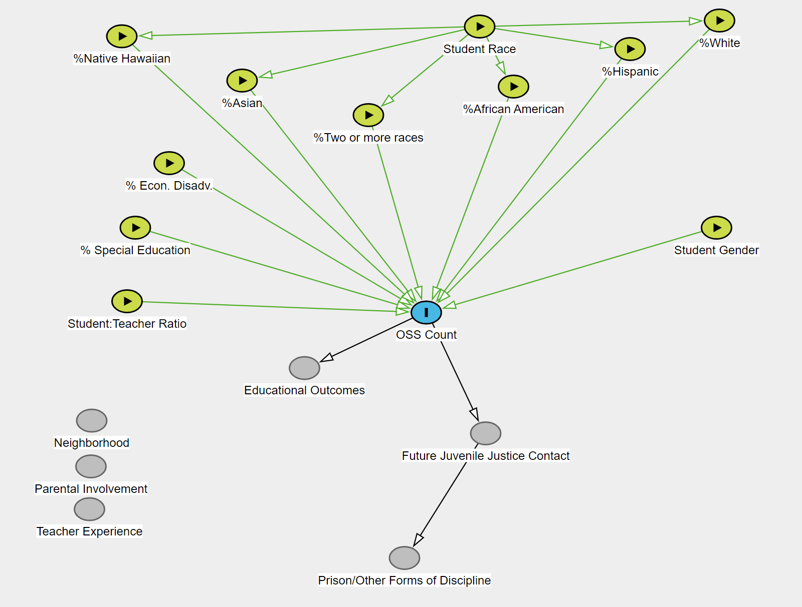
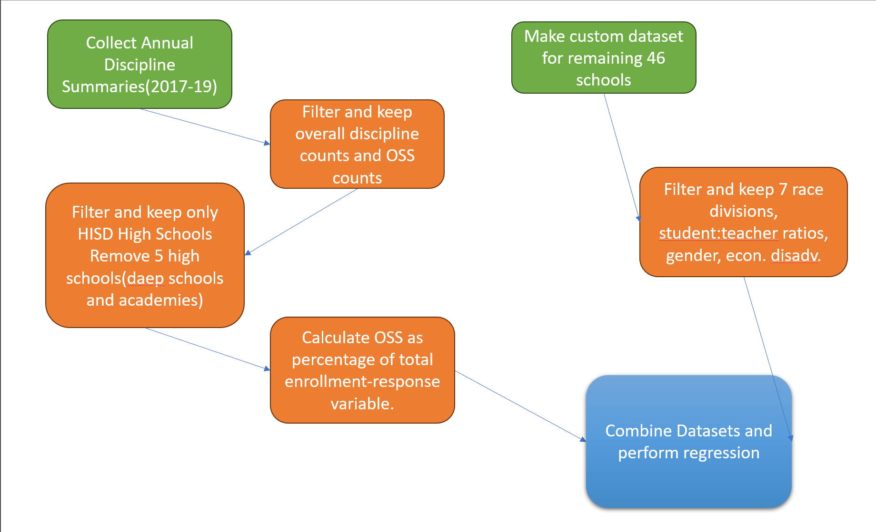
Effect of In & Out-of-School Factors on Houston Student Justice Outcomes
Anand Sabnis
HON 4355
Inspiration
Research Question
Research & Analysis
Inspiration
Poisson(Zero-inflated) Count Model Equation(most imp. Variables):
log(λ)=0.16(Hispanic)+0.17(Black)+0.19(White)+0.19(Asian)+0.035(EconDisadv.)+0.02(Male)
Other variables were removed due to collinearity and overfitting issues.
This topic is a direct continuation of my previous work on understanding the differences in student discipline rates. I had an interest in understanding how different factors affect discipline rates in HISD school students.
What is the impact of race and other factors on the chances of receiving an Out-Of-School Suspension?
Conceptual DAG
Background
Among different types of disciplining practices, Out-of-school suspensions have a strong linear relationship with future justice encounters.​Socio-economic disparities, racial inequalities, and diverse cultural backgrounds contribute to the chance of an OSS. Understanding the interplay of these factors is crucial for developing policies that break the school-to-prison pipeline. 4 variables have been picked to measure their importance in determining the count of OSS per school: Students’ gender, students’ race(7 subparts), students who were economically disadvantaged(TX),the student: teacher ratio.
Some variables were removed because I wanted to focus only on the first occurrence of OSS.
The students most likely to receive an OSS were students who were Hispanic, students who were African American, students who were economically disadvantaged and students were male.
Conclusion and Limitations
Timeline
School-to-Prison Pipeline
Based on the data, the most significant variable when measuring OSS is Race.
Some limitations that may affect my research include the chosen variables included in the final model, data inaccuracies/loss due to FERPA guidelines(removing value if value is too low)
Due to the COVID pandemic shifting schooling online and disrupting disciplining numbers, I’ve decided to look at data during the 2017-19 school years. Another reason for this is that the TEA expanded data categories in their data collection post 2016, and this change was made to keep the data uniform. The campus-wide summaries also change format post 2016.
Methodology
OSS Counts by Race(2017-19)
References
46 High Schools were picked from HISD to train a regression model that predicts the count of Out-Of-School Suspension.
TEA Annual Discipline Summary-State and Campus Level Data
Rice HERC Equity Project
Acknowledgements
Future Study
I would like to thank the Data and Society Faculty Team-Dr. Ioannis Konstantinidis, Dr. Andrew Kapral and Dr. Dan Price for their guidance throughout this undertaking.
I would also like to thank the author of the Rice Herc Research Publication-Dr. Horace Duffy for inspiring me to do this research.
Some ways to expand my current topic into
future studies are exploring the role of teacher training programs and restorative justice in addressing these identified variables, doing comparative analyses with other urban school districts and even states to understand how state policy affects student discipline.
All data was handled in Excel and modelling was carried out in R-Studio

